Slide 1

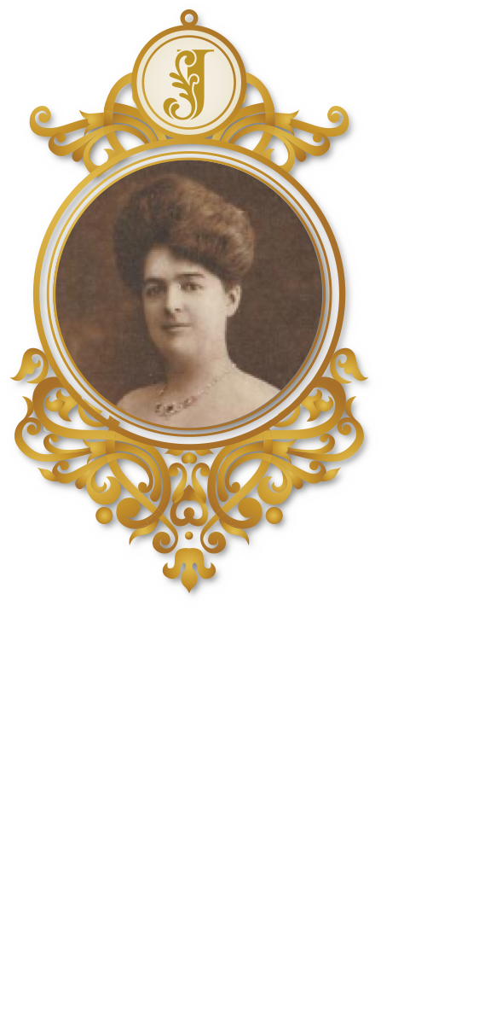
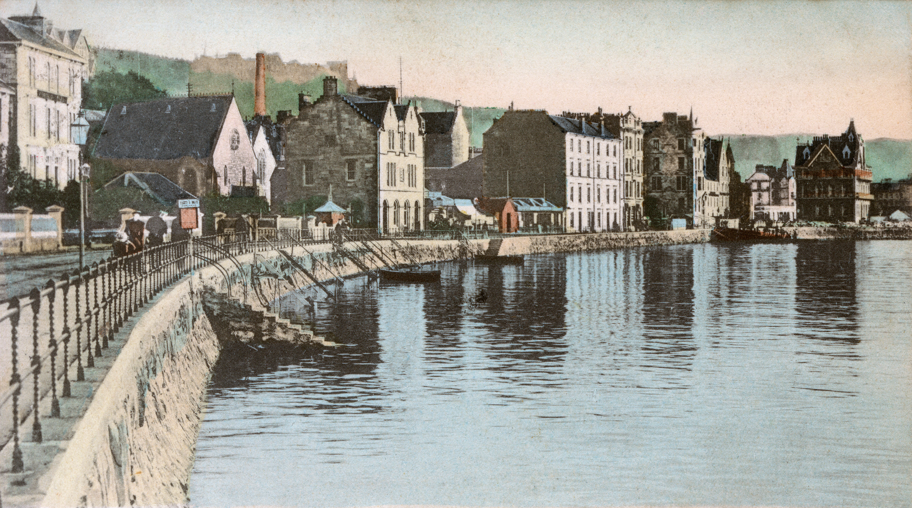
Jessie Niven MacLachlan (1866–1916)

Slide 2
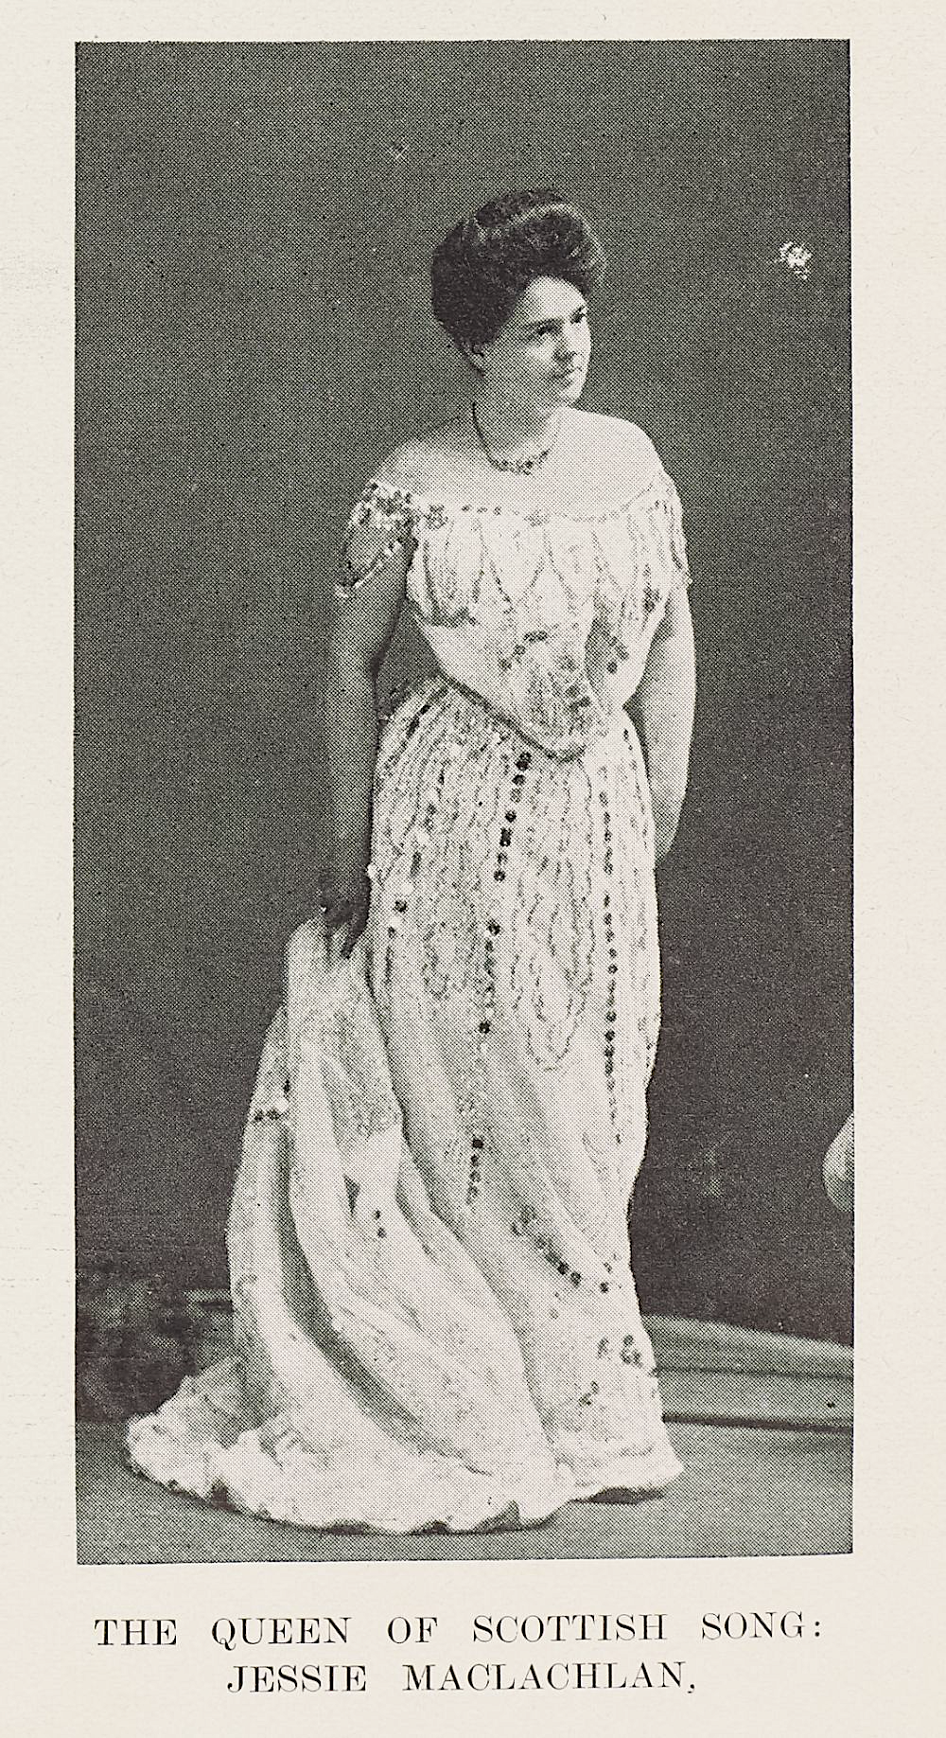
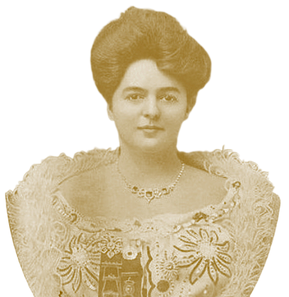

Jessie Niven MacLachlan (1866 - 1916)
Jessie MacLachlan was a famous singer.
She sang in big, impressive halls around the world.
Thousands came to hear her sing.
She sang Scottish songs so beautifully, that people called her
‘The Queen of Scottish Song’.

Slide 3
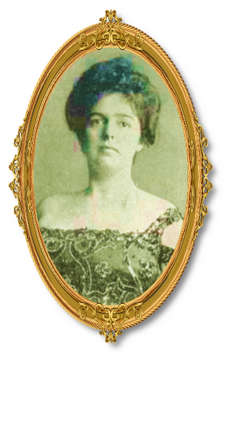

‘Smeòrach nan Gàidheal’
Wherever Jessie MacLachlan sang, she always had Gaelic songs in her programme.
She was proud of the language she learned as a young girl in Oban.
‘The Song-thrush of the Gaels’ was what the Gaels called here – do you know why?

Slide 4
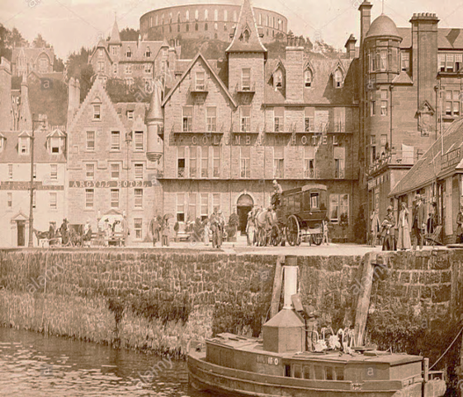


1: Nighean òg a’ fàs suas anns an Òban
Jessie was only eight years old when she started singing in the church choir.
Singing and Gaelic were in the family, and Jessie sang Gaelic songs when
she was young.
Her voice was so beautiful that people in the town advised her parents that
she should have a professional training.

Slide 5
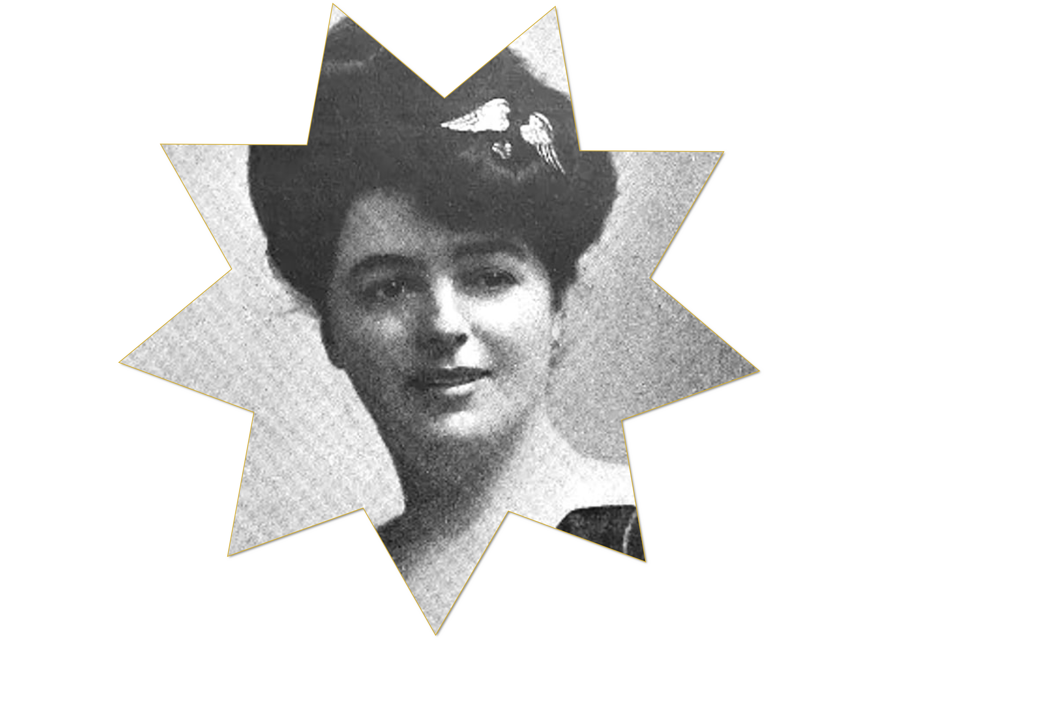
Jessie first went to Glasgow – the first
step on the road to becoming a big
star.
She was about seventeen at the time – how do you think she felt, leaving
Oban to go to the big city?

Slide 6
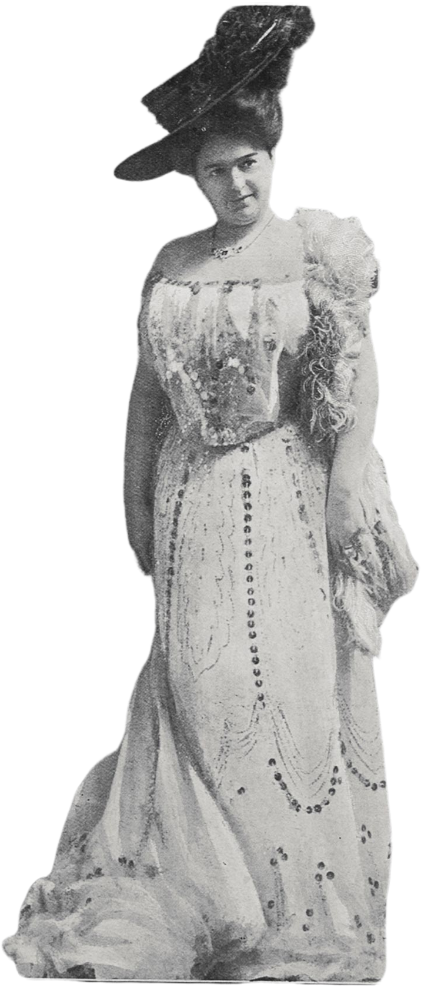

As I became more proficient at singing, I was sent to Glasgow for more advanced tuition. I was determined to make a profession of singing and so I went to London and studied popular opera, oratorio, and standard songs.
From Glasgow, Jessie went to London to train in music and singing.
She could have been a classical singer, but she valued traditional Scottish songs, and she wanted to sing Gaelic songs from her own tradition as well.

Slide 7

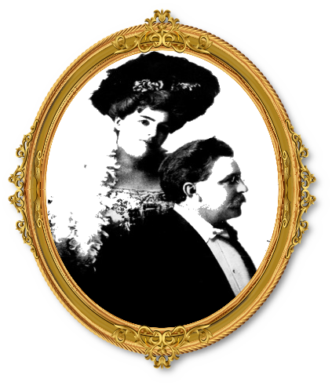
Jessie returned to Glasgow, where she met the musician, Robert Buchanan, who was a pianist and organist. They married in 1887.
Every time Jessie sang on stage, Robert accompanied her on the piano, or
sometimes on the organ.

Slide 8
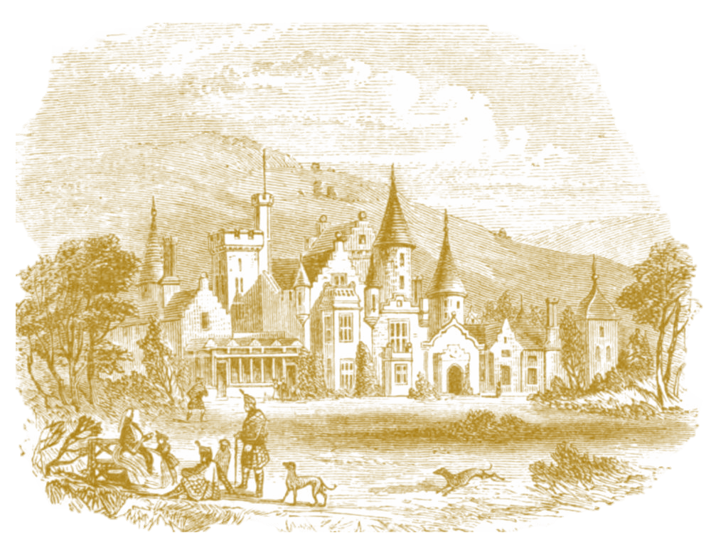
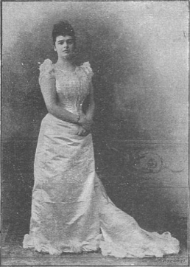

2: A’ Singing Before the Queen
In 1892, Jessie MacLachlan was invited to Balmoral Castle to sing for Queen Victoria.
What an honour, and what a to-do to prepare for!

Slide 9

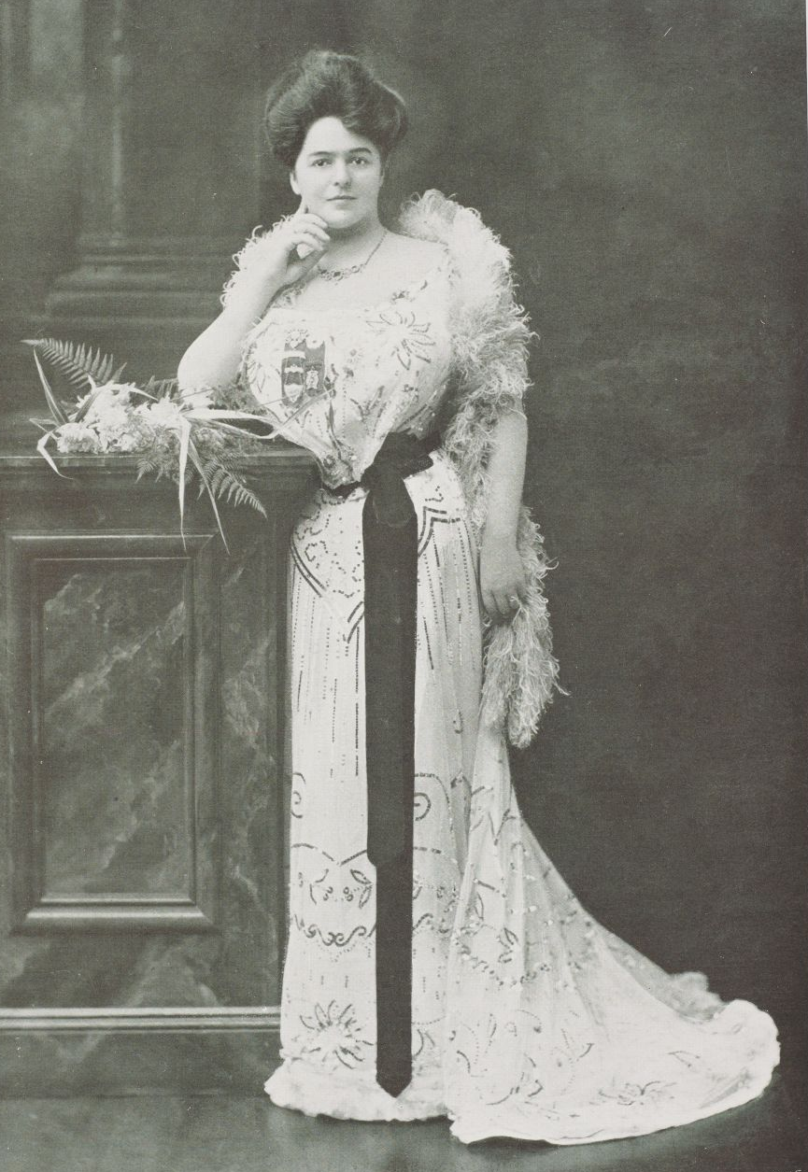
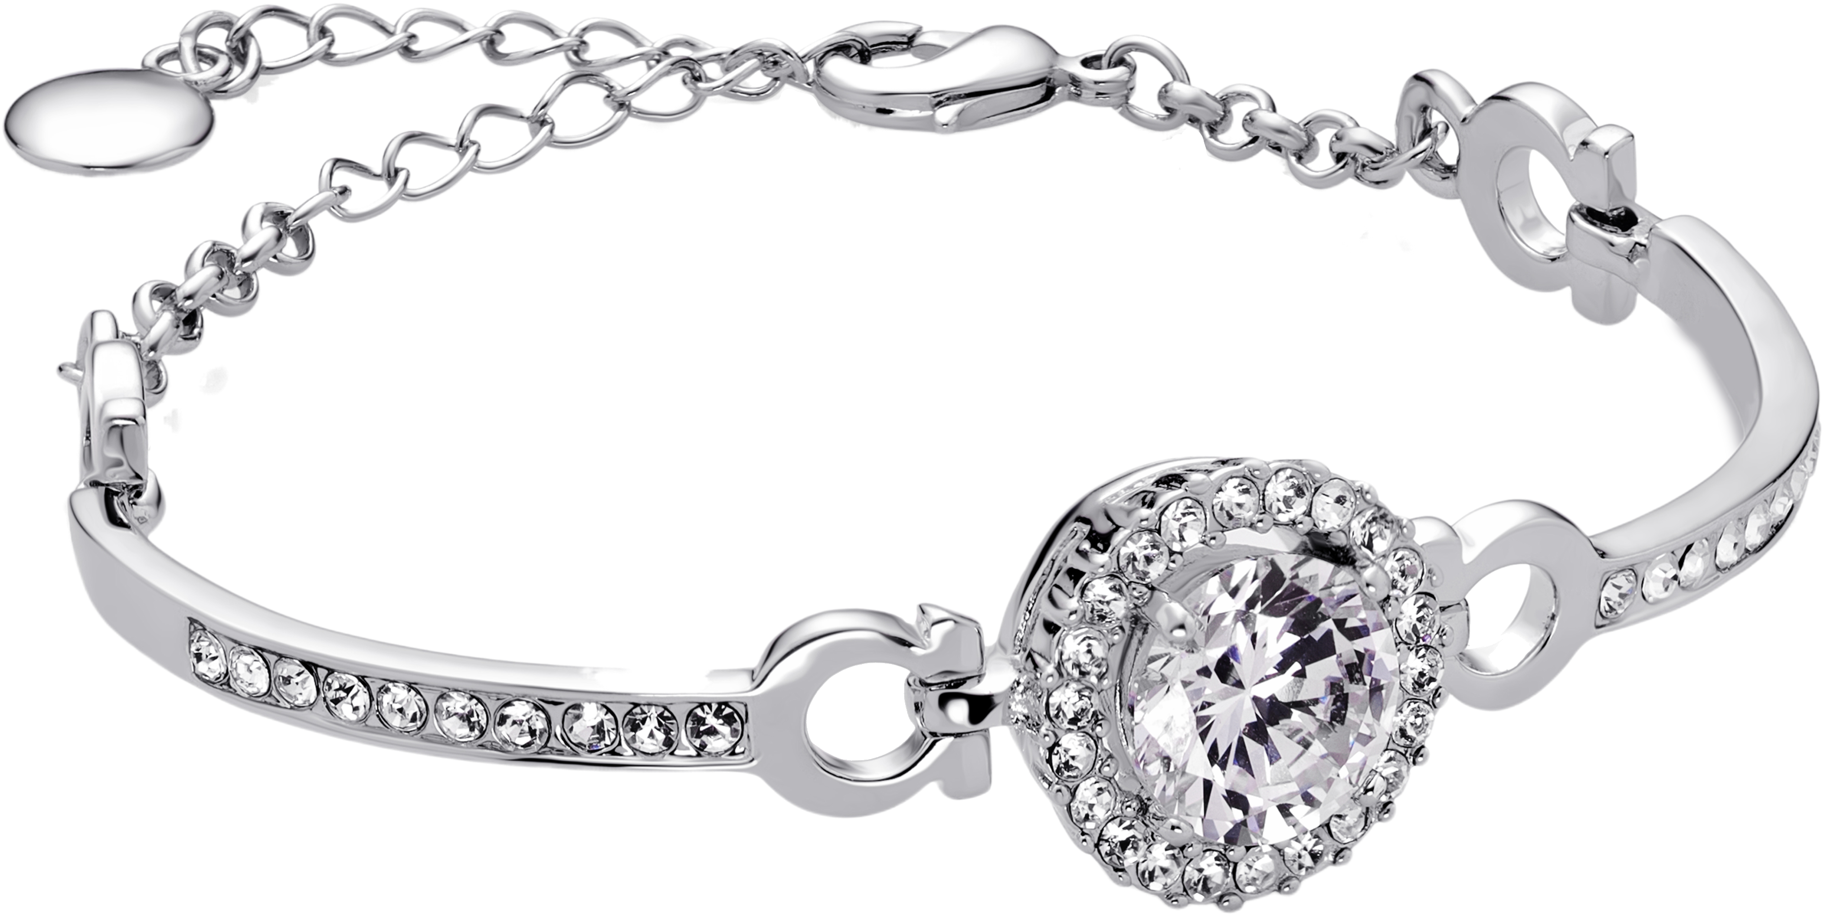

Jessie sang eight songs for the queen: four in English and four in Gaelic.
The queen enjoyed the songs very much, especially the Gaelic songs.
Queen Victoria gave Jessie a jewelled bracelet as a thank-you present, with
an inscription:
‘From Victoria Regina to Jessie MacLachlan, Queen of Scottish Song’.

Slide 10
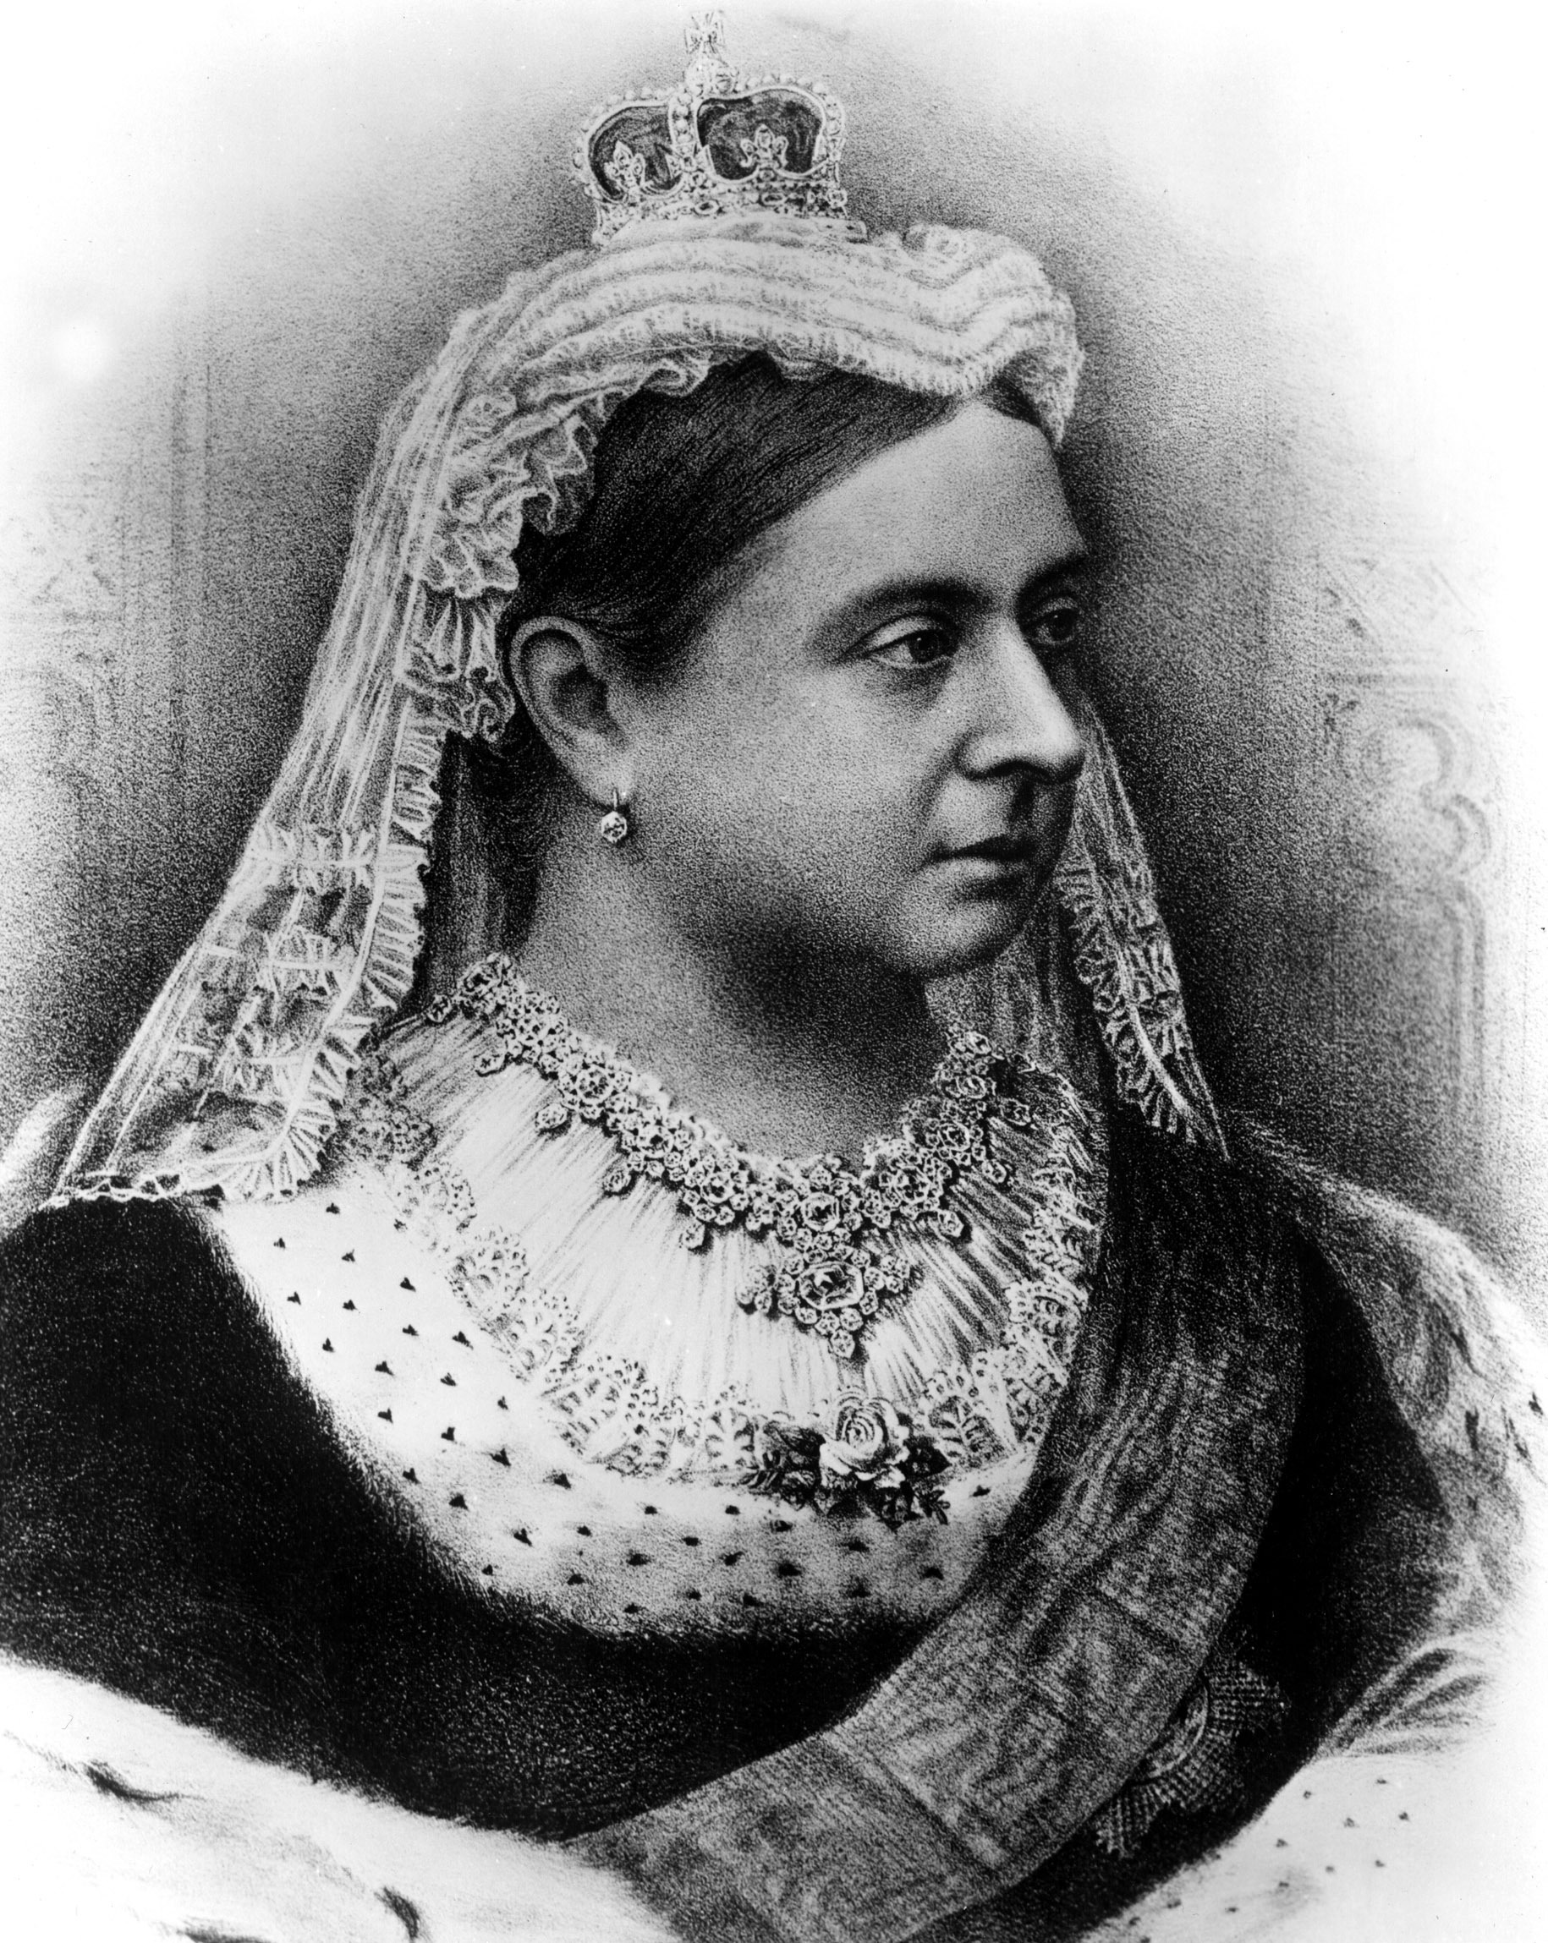
Did you know?
Queen Victoria was very fond of Gaelic!

Slide 11
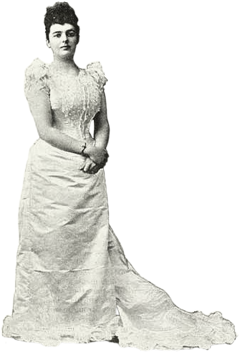
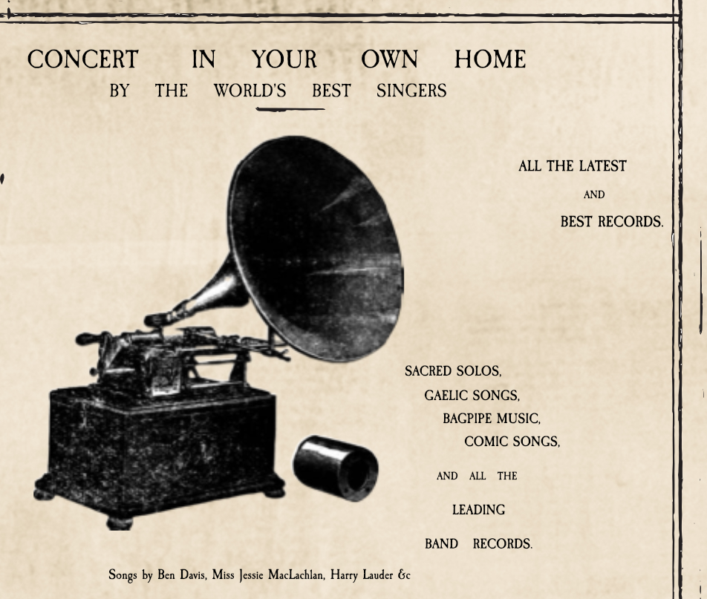
3: Gaelic Songs on a Gramophone Record
In 1899, Jessie MacLachlan’s singing was recorded in Glasgow with brand-new technology – the Gramophone.
Jessie sang two Gaelic songs, ‘Ho ro mo nighean donn bhòidheach’ and ‘Mo Dhachaidh’ – the first Gaelic songs that were ever recorded on a
gramophone record.
These old recordings give us a chance to hear Jessie MacLachlan’s beautiful
voice today.

Slide 12
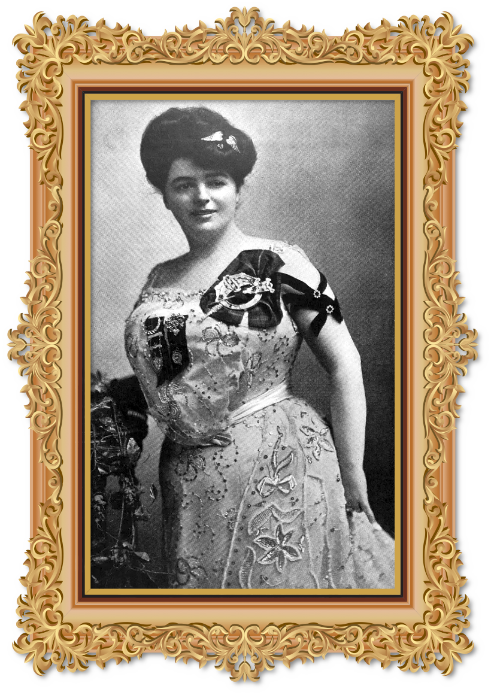
4: Singing All Over the World
In 1901, Jessie MacLachlan went on her first song-tour, to Canada and the States.
Jessie received a warm welcome, especially from Scots who had emigrated, many of them Gaels.
Jessie travelled far and wide for three months, to full houses wherever she went.

Slide 13
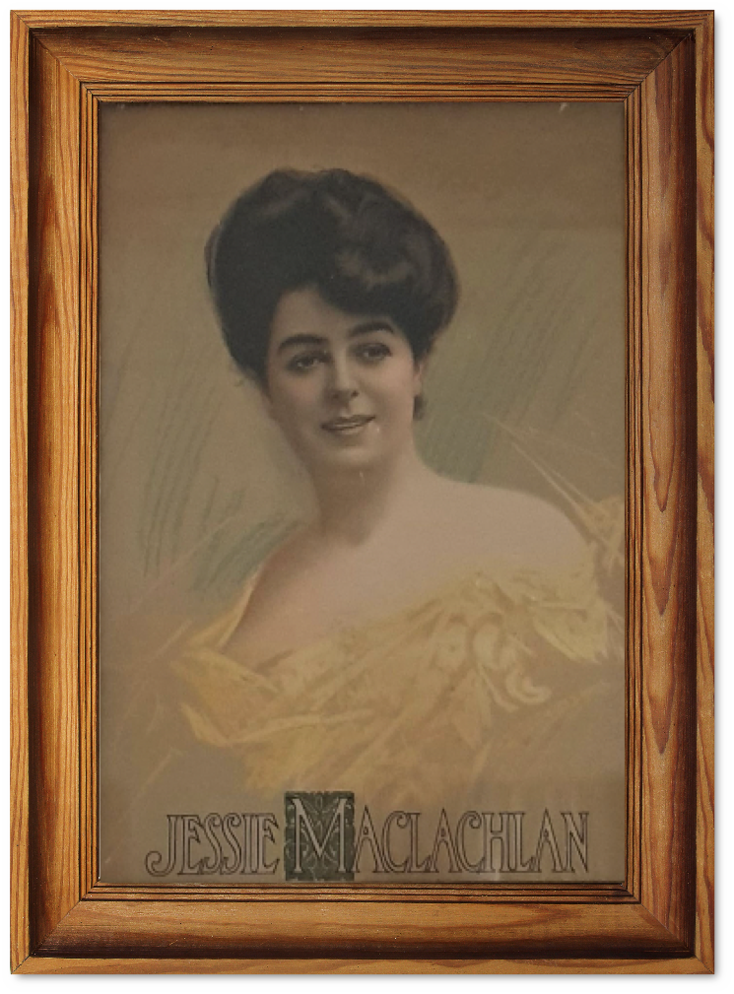

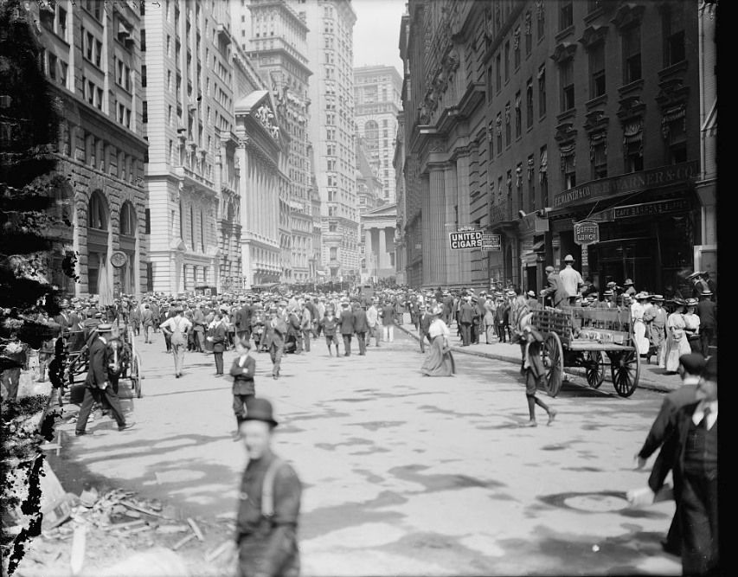
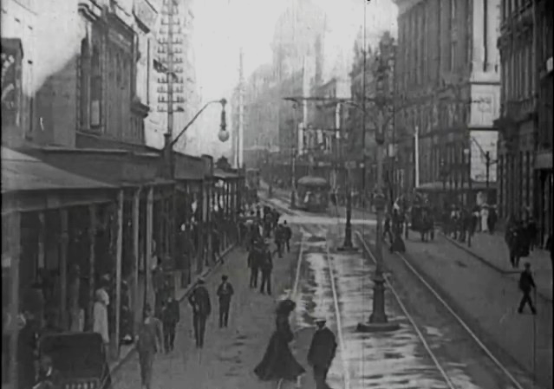
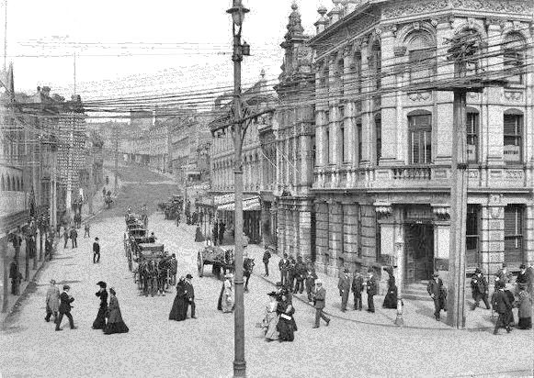
Between 1900 and 1914, Jessie MacLachlan toured Canada and the States
many times, and in 1905 and 1907 she toured Australia and New Zealand.

Slide 14
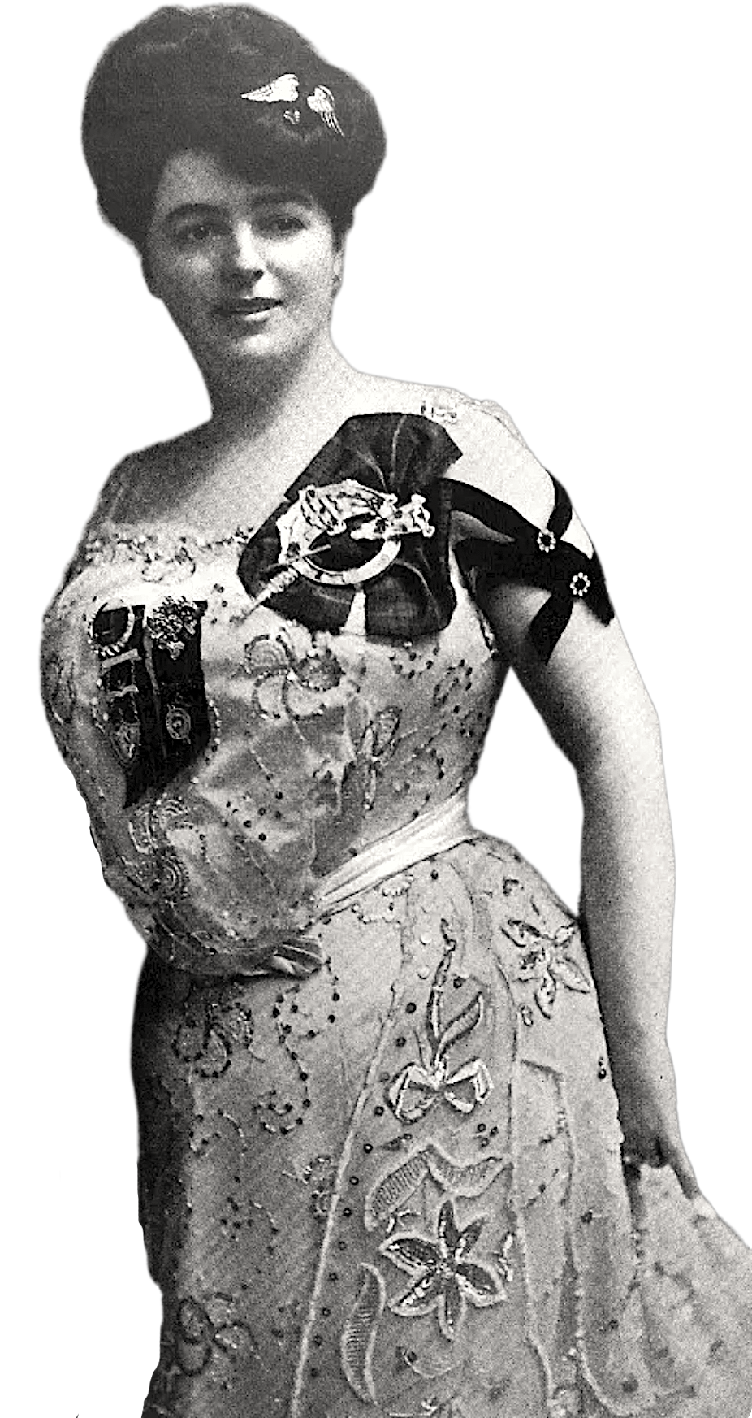
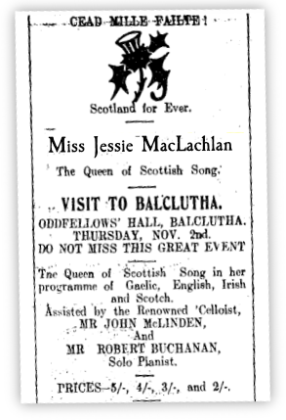
Jessie MacLachlan was given ‘A Hundred Thousand Welcomes’ when she sang in New Zealand in 1905.

Slide 15
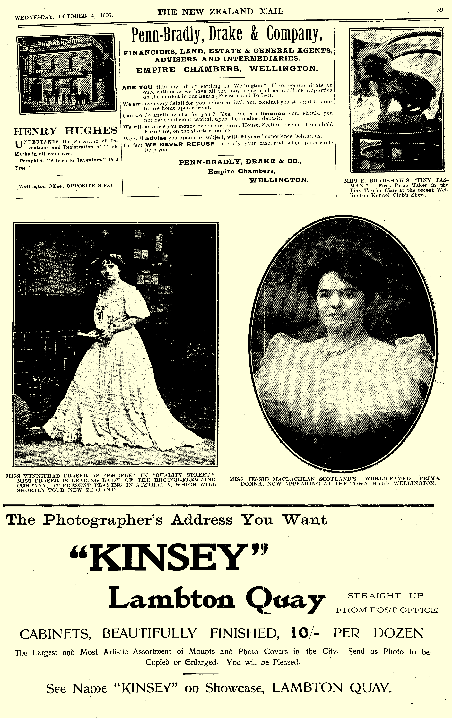
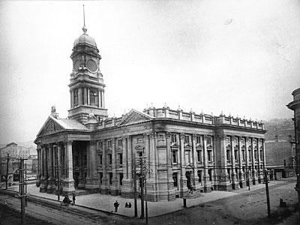

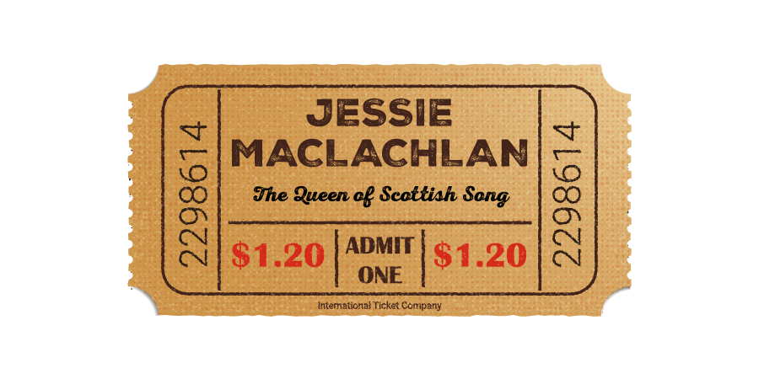
Jessie sang in famous concert halls in cities such as Wellington, Sydney, Melbourne, New York, Chicago, Ottowa, Toronto…
Melbourne, New York, Chicago, Ottowa, Toronto…

Slide 16
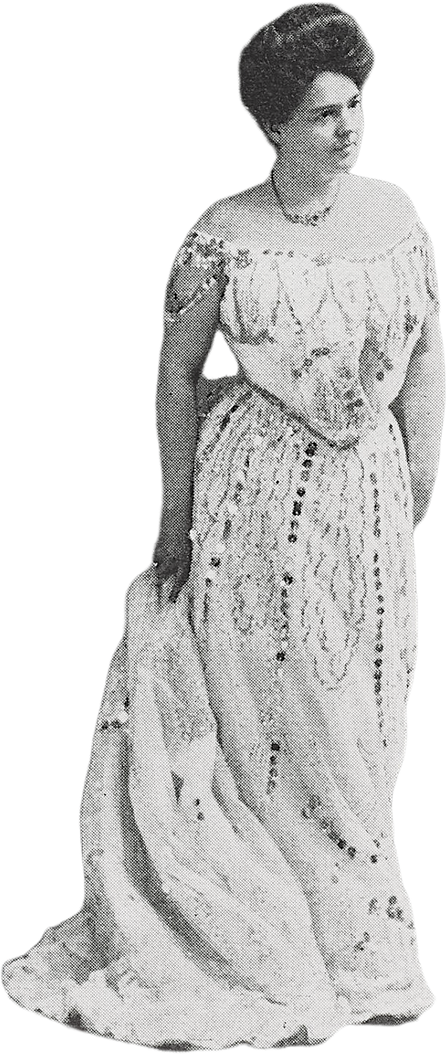
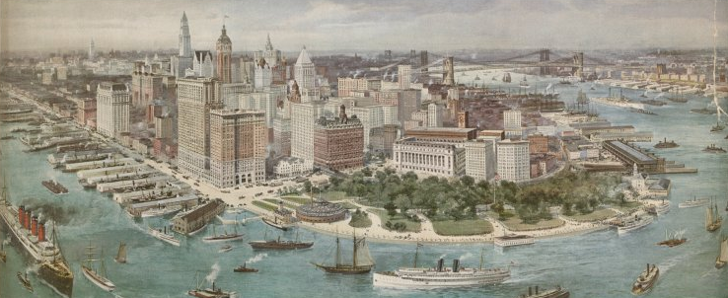
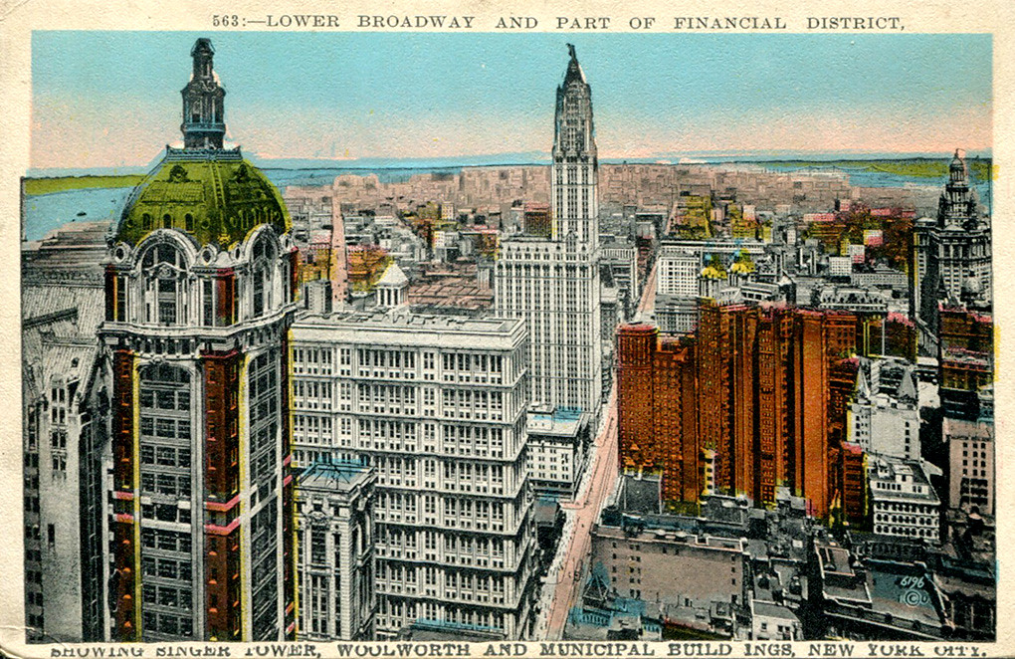
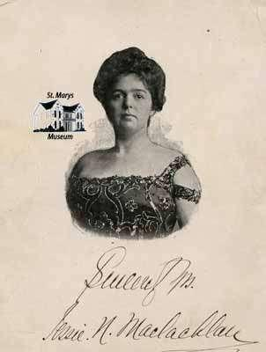
In March 1914, Jessie MacLachlan sang to 5000 people in New York.
Although she didn’t know it at the time, this was the last time she would be on a stage.

Slide 17
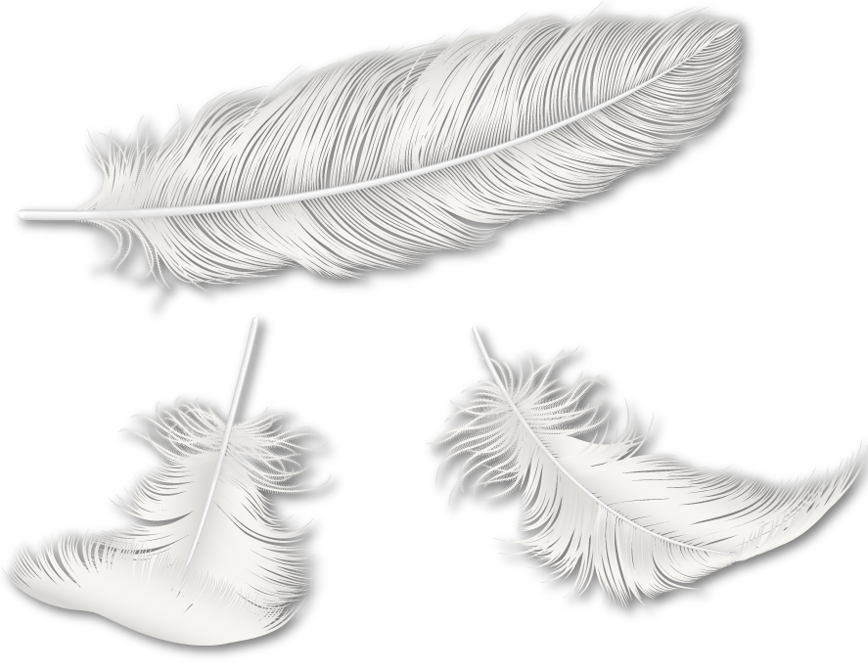
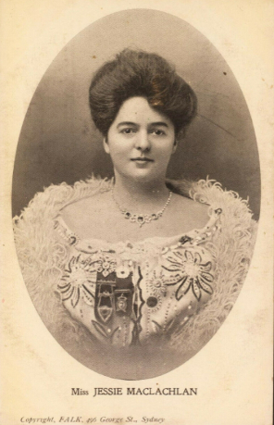

On the way back to Scotland after a long tour in Canada and the United
States of America, Jessie and her husband went to France for some rest.
While they were there, the Great War broke out and they barely made it back to Britain on board a cargo-ship with no clean water. Jessie never recovered and she died on the 19th May 1916.
She was buried in Cathcart Cemetery in Glasgow where a beautiful Celtic cross was erected in 1921 in her memory.

Slide 18
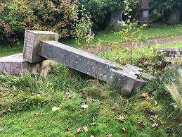
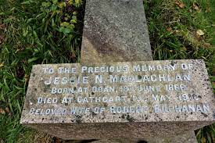
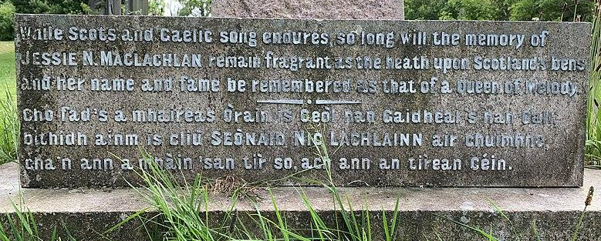
Over the years, Jessie MacLachlan’s voice, and all she did to share Gaelic
songs the world, was forgotten, and her memorial cross fell to the ground.

Slide 19
There is an old Gaelic proverb: ‘Remember the people that you came from’,
and by re-telling Jessie MacLachlan’s amazing story, we hope that people will
remember her again with honour and pride.
In 2022, Jessie's memorial cross was repaired so that all can see and learn of the memory of the amazing singer and Gaelic feminine icon that was Jessie Niven MacLachlan.

Slide 20


www.watercolourmusic.co.uk | www.storlann.co.uk. | www.gaelic.education
© Màiri Anna NicUalraig & Kerrie Cheannadach 2022

